Slide 1
Location TVM
Final Project

Slide 2
Team
Achraf KASSIMI
Hassan EL FAQIR
Yassine TALEB

Slide 3
Brief Description
The latest software engineering project in our group 19 called "LOCATION TVM" is a website that allows users to save money and time, and we are carefully served to ensure the convenience we offer for the perfect transfer solution tailored to your needs.
Notes:
أحدث مشروع لهندسة البرمجيات في مجموعتنا 19 يسمى «LOCITE TVM» هو موقع ويب يسمح للمستخدمين بتوفير المال و الوقت، ويتم خدمتنا بدقة لضمان الراحة التي نقدمها لحل النقل المثالي المصمم خصيصًا لاحتياجاتك.

Slide 4
Technologies
Front-end: HTML, CSS, JavaScript, Bootstrap, React
Back-end: Phyton, Flask, SQLAlchemy,API

Slide 5
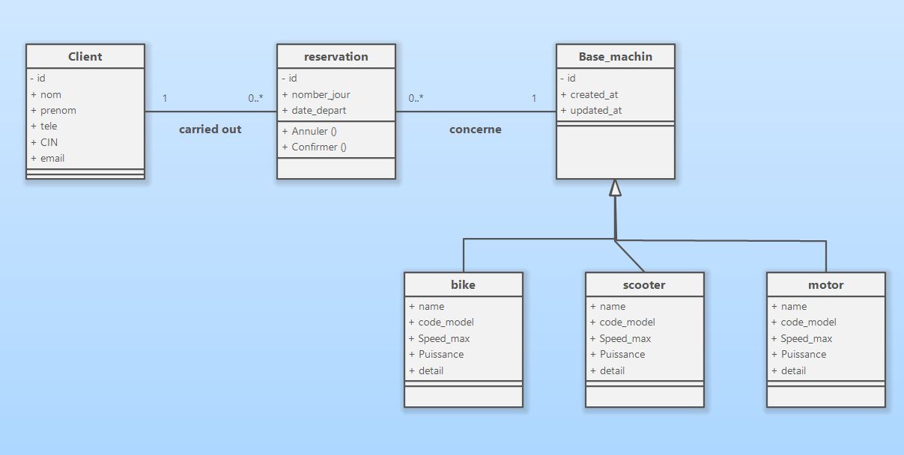
ARCHITECTURE

Slide 6
Designing a website for a Tracker involves several components and layers, each serving a specific purpose.
Front-end (Client Side):
This is the user-facing part of the application, where users interact with WellNest tracker.
Frameworks/Libraries: React.js for building a dynamic and responsive user interface.
Components:
Dashboard: Overview of user’s health and wellness data.
Data Entry Forms: Forms for entering data such as diet, exercise, sleep, and other health metrics.

Slide 7
Visualization Tools: Charts and graphs to display progress and trends over time.
User Authentication: Login and registration forms, password reset functionality.
Notifications and Reminders: Alert users about their goals, upcoming activities, or any health concerns.

Slide 8
2. Back-end (Server-Side):
This part of the application handles data processing, business logic, and communication between the frontend and the database.
Framework: Node.js with Express.js
API Layer: RESTFul APIs or GraphQL, Cors, Crypto for handling requests from the frontend.
Authentication: JWT (JSON Web Tokens) or OAuth2 for user authentication and authorization.

Slide 9
Business Logic:
- Data validation and processing.
- Goal tracking and progress calculations.
- Notification scheduling and management.

Slide 10
3. Third-Party Integrations:
To enhance functionality, the web app can integrate with various third-party services.
APIs:
Fitness Trackers: (Fitness API, Google APIs, People APIs).
Sleep Trackers.
Payment Gateways: For subscription services or premium features (e.g. Google pay).

Slide 11
4. DevOps and Deployment:
Ensuring the application is reliably deployed and maintained.
Github Actions for continuous integration and deployment.

Slide 12
Report on our progress, detailing accomplishments, problems improvements, lessons learned, and next steps.
Accomplishments:
Project Initiation and planning:
Defined project scope, objectives and deliverables.
Conducted initial market research to understand user needs and competition.
Development Milestones:
Front-End Development:
Designed and implemented the user interface using React.js

Slide 13
Created responsive layouts for mobile and desktop views.
Back-End Development:
Set up server-side architecture with NOde.js and Express.
Developed API endpoints for user authentication, data retrieval, and data storage.
Database Integration:
Integrated database with the back-end to handle user data and wellness metrics.

Slide 14
Feature Implementation:
User authentication and profile management.
Tracking features for various wellness metrics (e.g. diet, exercise, sleep).
Data visualization tools (charts and graphs) to monitor progress.
Testing and Debugging:
Conducted unit and integration tests to ensure functionality.

Slide 15
2. Problems Encountered:
Technical Challenges:
Initial difficulties in integrating React.js with the back-end.
Performance issues with database queries, which were resolved by optimizing the schema and indexing.

Slide 16
Project Management:
Underestimated time required for testing and debugging phases.
Communication gaps within the team, leading to some delays.
3. Improvements Made:
Technical:
Refactored code for better maintainability and performance.
Enhanced user interface for better usability and accessibility .

Slide 17
Implemented caching mechanisms to improve database query performance.
Project Management:
Improved communication channels using project management tools like “Trello”.
4. Lessons Learned:
Technical:
Importance of thorough planning and designing before starting development.
value of automated testing code quality and reducing bugs.

Slide 18
Project Management:
Necessity of clear communication and setting realistic deadlines.
Importance of flexibility and adaptability when facing unexpected challenges.
5. Next Steps:
Feature Enhancements:
Develop a recommendation system for personalized wellness advice.

Slide 19
Deployment:
Prepare for deployment by setting up a production environment.
User Feedback and Iteration:
Iterate on the application based on feedback to improve user experience and functionality.
Marketing and Outreach:
Develop a marketing strategy to promote WellNest.
Engage with potential users through social media and wellness communities.

Slide 20
Summary of our Experience
The WellNest project has made significant progress since its inception. Despite encountering various challenges, the team has successfully navigated them and made substantial improvements. With clear plans for future development and deployment, WellNest is on track to become a valuable tool for users seeking to track and improve their health and wellness.

Slide 21
ALX - Foundation
Alx_africa
Cohort 17 Mentors
Thank you

Slide 22
PRÉSENTATION DU MARCHÉ
3 milliards €
1 milliard €
2 milliards €
Liberté de création
Marché inclusif de manière sélective
Segment de marché disponible
Opportunité de créer
Marché inclusif
Marché potentiel global
Faible concurrence
Marché ciblé spécifiquement
Part de marché disponible

Slide 23
Comparaison des marchés
3 Mds €
2 Mds €
1 Md €
Opportunité de créer
Liberté de création
Faible concurrence
Marché potentiel
Segment de marché
Part de marché

Slide 24
LA CONCURRENCE
CONTOSO
CONCURRENTS
Notre produit est moins cher que celui des autres entreprises sur le marché
La conception est simple et facile à utiliser, contrairement aux conceptions complexes de nos concurrents
Le prix abordable est le principal attrait de nos consommateurs pour notre produit
Entreprise A Le produit est plus cher
Entreprises B et C Le produit est cher et difficile à prendre en main
Entreprises D et E Le produit est abordable, mais difficile à prendre en main

Slide 25
La concurrence
Pratique
Contoso
Concurrent A
Abordable
Onéreux
Concurrent D
Concurrent C
Concurrent B
Concurrent E
Peu pratique

Slide 26
Stratégie de croissance
Févr. 20XX
Déployer le produit auprès de participants expérimentés pour améliorer le produit
Mars 20XX
Proposer le produit au grand public et surveiller les communiqués de presse et les réseaux sociaux
Oct. 20XX
Recueillir les commentaires et ajuster la conception du produit si nécessaire

Slide 27
TRACTION
Prédire le succès
Indicateurs clés
 | Clients | Commandes | Chiffre d’affaires brut | Chiffre d’affaires net
20XX | 10 | 1100 | 10 000 € | 7 000 €
20XX | 20 | 200 | 20 000 € | 16 000 €
20XX | 30 | 300 | 30 000 € | 25 000 €
20XX | 40 | 400 | 40 000 € | 30 000 €
Chiffre d’affaires par an

Slide 28
PLAN D’ACTION BIENNAL
RÉDIGER LES PREMIÈRES VERSIONS DU PROJET
RECUEILLIR LES COMMENTAIRES
LIVRER AU CLIENT
20XX
JAN
FÉV
MAR
AVR
MAI
JUIN
JUIL
AOÛ
SEPT
OCT
NOV
DÉC
20XX
JAN
FÉV
MAR
AVR
MAI
JUN
JUIL
AOÛ
SEP
OCT
NOV
DÉC
ORGANISER DES GROUPES DE DISCUSSION
TESTER LA CONCEPTION
LANCER LA CONCEPTION

Slide 29
FINANCES
 | Année 1 | Année 2 | Année 3
BÉNÉFICES
Utilisateurs | 50 000 | 400 000 | 1 600 000
Ventes | 500 000 | 4 000 000 | 16 000 000
Prix moyen par vente | 75 | 80 | 90
Chiffre d’affaires à 15 % | 5 625 000 | 48 000 000 | 216 000 000
BÉNÉFICE BRUT | 5 625 000 | 48 000 000 | 216 000 000
Dépenses
Ventes et marketing | 5 062 500 | 38 400 000 | 151 200 000 | 70 %
Service client | 1 687 500 | 9 600 000 | 21 600 000 | 10 %
Développement de produit | 562 500 | 2 400 000 | 10 800 000 | 5 %
Recherche | 281 250 | 2 400 000 | 4 320 000 | 2 %
TOTAL DES DÉPENSES | 7 593 750 | 52 800 000 | 187 920 000

Slide 30




PRÉSENTATION DE L’ÉQUIPE
LOUIS DESHOUX
SACHA BELISLE
ALINE DUPUY
ROMAIN PETIT
Président
Directrice générale
Directrice d’exploitation
Vice-Président du marketing

Slide 31








PRÉSENTATION DE L’ÉQUIPE
LOUIS DESHOUX
SACHA BELISLE
ALINE DUPUY
ROMAIN PETIT
Président
Directrice générale
Directrice d’exploitation
Vice-Président du marketing
ALEXANDRE CHAUVIN
LUC LACOMBE
ÉLISABETH ARCOUET
MARIE MÉTHOT
Vice-président de produit
Spécialiste du référencement
Conceptrice de produit
Développeuse de contenu

Slide 32
FINANCEMENT
14 000 €
12 000 €
82 000 €
32 000 €
INVESTISSEURS
PROPRIÉTÉ
ACTIONS
LIQUIDITÉS
Montant obtenu auprès d’autres investisseurs
Revenus provenant de la location de biens
Nombre d’actions converties en Euros
Liquidités dont nous disposons

Slide 33
SYNTHÈSE
Chez Contoso, nous nous donnons toujours à 1 000 %. En utilisant notre architecture de données nouvelle génération, nous permettons aux organisations de gérer virtuellement des workflows agiles. Nous prospérons grâce à notre connaissance du marché et à l’excellente équipe qui travaille sur notre produit. Comme le dit notre PDG, « La rentabilité provient des changements effectués dans notre façon de travailler. »

Slide 34
MERCI
Sacha Belisle
206-555-0146
sacha@contoso.com
www.contoso.com

